Slide 1
Computational Linguistics and Natural Language Processing
DISCOURSE – AWARE AUTOMATIC TEXT SUMMARIZATION
Mrs.S.Reshni

Slide 2
TEAM MEMBERS
NAME | REGISTER NUMBER
N.Venkata Siva Sai Charan | 99210041360
Narendra Datta Alladi | 99210041600
Sai Harsha Panthagani | 9921004624
Narsimha Y | 9921004500
Muvva Hari Krishna | 9921004479
B.v.S Anantha Kumar | 9921004068

Slide 3
PROBLEM STATEMENT
Discourse-aware automatic text summarization is a natural language processing task that focuses on generating concise and coherent summaries of longer texts while taking into account the discourse structure and relationships between sentences or paragraphs in the original text.

Slide 4
INTRODUCTION
Automatic Text Summarization: It's a technology that helps reduce long texts into shorter, more manageable summaries.
Discourse-Aware Summarization: This approach focuses on maintaining the structure and flow of the original text.
Focus on Relationships and Flow: It considers how sentences are connected in the text.
Going Beyond Traditional Methods: Unlike traditional summarization, it preserves the context and connections between sentences.
Preserving Context and Coherence: It ensures that the summary makes sense and is easy to understand.

Slide 5
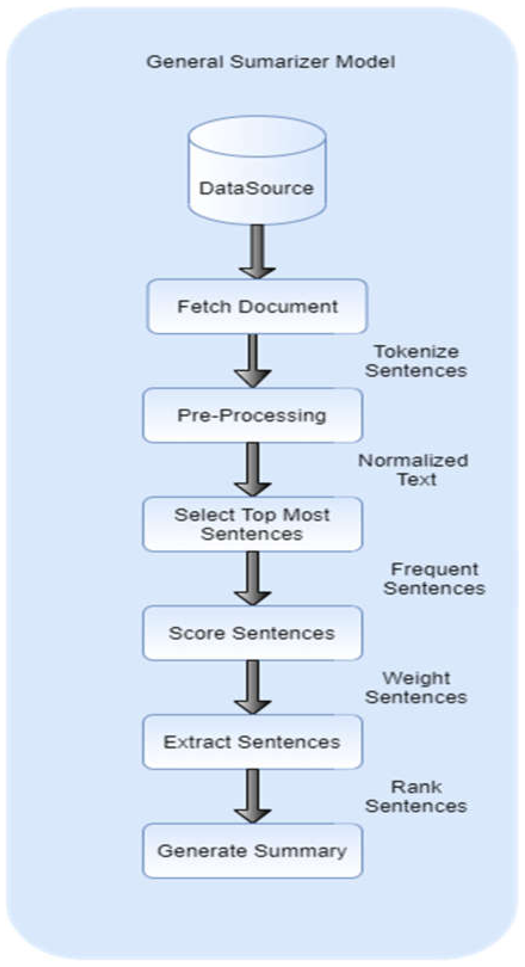
FLOW CHART

Slide 6
Data Collection: Gather a diverse and representative dataset of text documents that need to be summarized. This dataset should cover a range of topics and writing styles.
Preprocessing: Prepare the text data by cleaning and structuring it. This may involve tasks like sentence tokenization, removing stop words, and identifying discourse elements (e.g., transitions, relations between sentences).
Feature Engineering: Define and extract features that capture discourse-related information. These features could include sentence position, discourse markers, and semantic similarity measures between sentences.
Model Selection: Choose or design a text summarization model that can incorporate discourse awareness. This may involve the use of graph-based models, neural networks, or rule-based approaches, depending on the project's goals.

Slide 7
Training: Train the selected model on the prepared dataset. The model should learn to identify important discourse elements that contribute to the overall coherence and context of the text.
Evaluation: Assess the performance of the summarization model using appropriate evaluation metrics, such as ROUGE scores or human evaluation. The evaluation should focus on the quality of summaries in terms of coherence and relevance.
Fine-tuning: Refine the model based on the evaluation results. This may involve adjusting model hyperparameters or retraining with additional data.
Testing and Validation: Apply the discourse-aware summarization model to new text documents to validate its performance in real-world scenarios.
Comparison: Compare the results of the discourse-aware model with conventional text summarization methods to determine its effectiveness.
Documentation: Thoroughly document the methodology, including the dataset used, feature engineering techniques, model details, and evaluation results.

Slide 8
Discourse-Aware Techniques
Named Entity Recognition (NER): Identifying important entities like names, places, or organizations in the text to ensure they are included in the summary.
Abstractive Summarization: This involves generating summaries by rewriting the content in a more concise and coherent manner, often using techniques like neural language models.
Coreference Resolution: Handling cases where pronouns refer to previously mentioned entities, ensuring the summary is clear and coherent.

Slide 9
APPLICATIONS
Aware Automatic Text Summarization has various applications across different domains. Some major applications include:
News Summarization
Document Summarization
Academic Paper Summarization
Email Summarization
Content Curation
Textbook Summarization

Slide 10
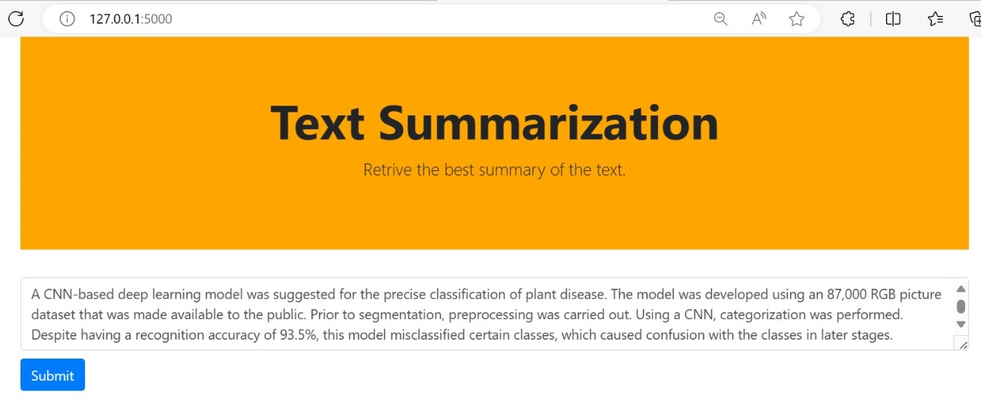
SAMPLE INPUT AND OUTPUT
SAMPLE INPUT

Slide 11
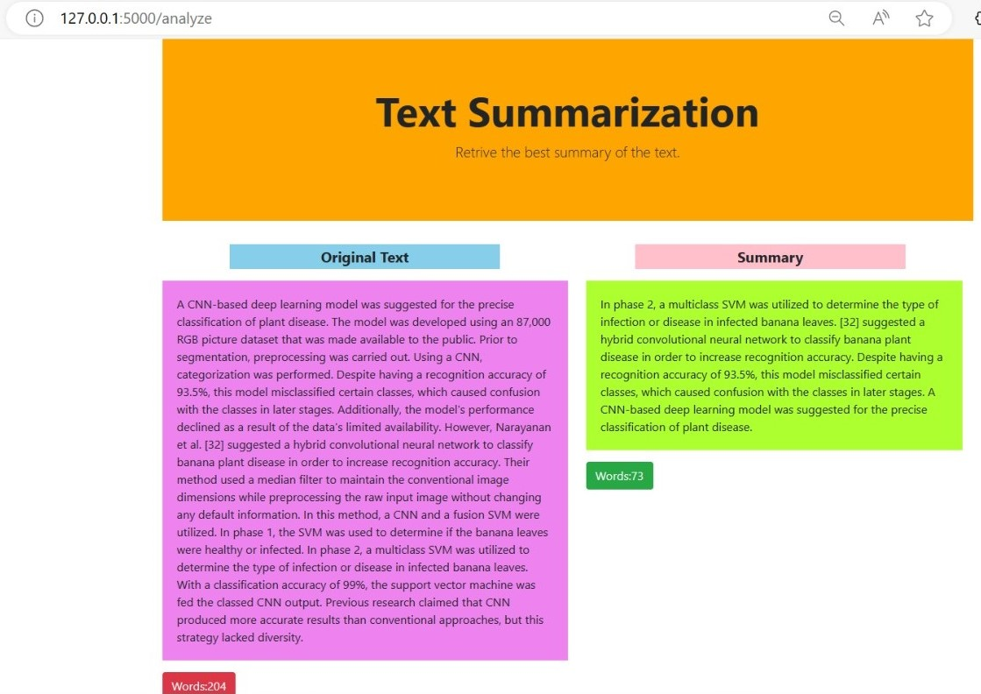
SAMPLE OUTPUT:

Slide 12
CONCLUSION
Transforming Information Consumption: Discourse-aware summarization can make it easier to digest and understand large amounts of information.
Accessing Valuable Insights Efficiently: It helps you quickly find and use the most important information from a text.

Slide 13
THANK YOU

